Slide 1
The title: The implementation of Data Protection
Author: Syuzi Hovhannisyan
Country: Armenia
University: Yerevan State University, Faculty of Law
Email: sy.hovhannisyan111@gmail.com

Slide 2
Meaning of terms
Data
The whole information about individuals
Controller
Organization or natural person which cultivates the information
Processor
Organization or natural person which controls the cultivation of information
Data subject
Physical person who can be identified
GDPR officer
The person who deals with monitoring and connection with government

Slide 3
As a fundamental right, Data Protection includes 2 important acts
The Data protection act 1998(Drafted in UK)
General Data Protection Regulations(DPD Data Protection Directive 1995 turned into GDPR)

Slide 4
The act of 1998 had 3 important principles
Fee for viewing
Correct the incorrect information.
Don’t use personal information in database marketing.

Slide 5
Some principles of P.D. – Personal Data
P.D. shall be processed lawfully
Information shall be kept for specific purposes.
P.D. shall be adequate
P.D. shall be obtained for lawful purposes
P.D. shall not be transferred outside the European Economic Area.
Technical measures shall be taken against loss of data.

Slide 6
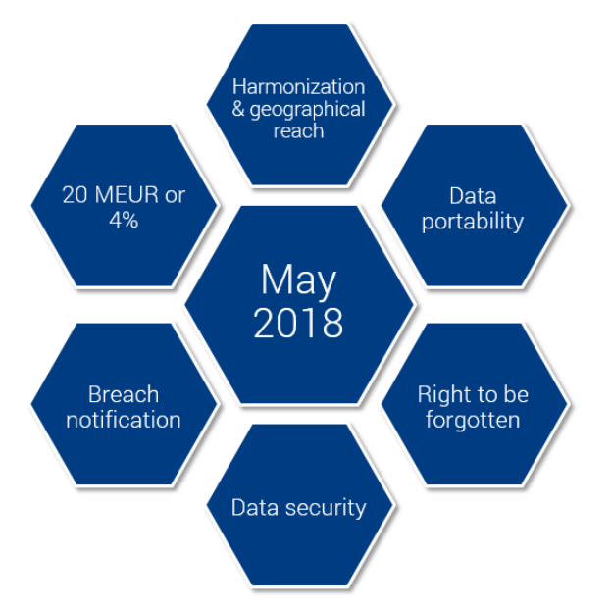
The May 25.
://www.professionalsuk.co.uk/
article/hr-consultants/3296/
my-take-on-gdpr

Slide 7
https://www.professionalsuk.co.uk/article/hr-consultants/3296/my-take-on-gdpr

Slide 8
About new rights
The right of access:You can request a free e -copy form of your stored data by a particular company.
The right to data portability: You can transfer your data whenever you want it from one service provider to another.
The right “ to be forgotten”: You can withdraw the consent you have given for the use of your personal data.
The right to be informed: At the outset of any request for data, businesses must be as clear as possible on how they will process data.

Slide 9
Right to rectification: When your personal data are inaccurate, then controllers need to correct them indeed.
The right to restriction of processing: Simply said, your right to limit the processing of your personal data with several rules and exceptions of course.
Notification right: In the event of a breach of data that compromises your personal data, the organization should inform the Processor within 72 hours of the first time that the violation was identified.
Right to object: You can immediately stop processing your data for marketing purposes.

Slide 10
The principle of GDPR based on agreement of Data Controller and Data Processor. The agreement must be done freely, only for correct purpose and lawfully. The cultivation of subject’s rights can have “high risks”, so the compliance with ISO 27001 is one and only independent and internationally recognized security standart .
DPO : there is a special officer
for Data protection, the officer
deals with monitoring
and connection with Government.

Slide 11
What advantages do the implementation of P.D. offers?
We can implement it only with complying GDPR with national legislation.
For complying we need local(national) laws.
After these we will have platform to base on in the event of violation of law.

Slide 12
Advantages of P.D.
You can lower taxis in different types of businesses.
Big companies and organizations can easily rely on P.D.( especially on GDPR’s officer who deals with legal part of companies and businesses).
The companies can’t escape from these, there is a penalty about 20 million euro.
Based on P.D. The Data transfer can be done safely.

Slide 13
The goal is the general protection of personal information for both natural and legal people.
Advice ICANN to change WHOIS system.
Make it private.
Build a bridge between public system and GDPR’s private regulations.

Slide 14
Ripe NCC has already shared GDPR’s
compliance model
Contains registration details
Contact details of responsible people
Contain details of resource holders
Database is open,
especially during offences
it is important for connection
between network operators

Slide 15
Removal of Personal Data
Resource holder can apply for removing the data.
In the same time the resource holder must find another individual who is willing to share their data in RIPE Database.
Conclusion
The RIPE NCC is confident that the current RIPE Database operations are in line with the requirements of the GDPR.

Slide 16
Why we need the Data Protection?
The statistic shows that organizations have lack of knowledge about the protection of personal information.
Organizations need GDPR in order to avoid from violation of rights and keep protected.
What can we do if we don’t want to comply our national legislation with the GDPR?
The organization can be fined
Is it essential for non-EU countries too?
Yes. Non-EU countries should have governmental decisions based on GDPR.
What advantages do the GDPR have for implementation?
It is fundamental right and platform for people to apply to court.

Slide 17
EU countries which will validate the regulations
Andorra, Argentina, Canada, Faroe Island, Guernsey, Israel, Isle of Man, Jersey, New Zealand, Switzerland, Uruguay are EU countries that will validate the regulations all other non-EU countries should transfer data only if they can provide proper conditions for protection.

Slide 18
About non – EU countries
The compliance of EU agreement with national legislations is the main problem that countries must solve after adopting it.
Non-EU countries will do the same, they will add regulations which will be in compliance with GDPR.
In any non-EU country that isn’t mentioned in this list should has own national legislation which will compliances with GDPR(ISO 27001 standart), because every country should has own standarts for proper protection and every citizen should know that his/her rights are protected.

Slide 19
What influence can GDPR have on Eastern Europe and Armenia?
The main problem is the cybercrime. The rate of cybercrime in Armenia increases(According to the annual report of Armenian police to the Government).
With the GDPR we are getting a reliable platform on when we want to apply to the court.
It is a very safe way for our Data protection.

Slide 20
We need a long time to implement the Data protection
Only 15% realize the changes that GDPR offers.
GDPR will be available since May 25.
People should understand the principles of this fundamental right
https://gdpr-info.eu/

Slide 21
Reference list
https://gdpr-info.eu/
https://www.equalityhumanrights.com/
https://www.papaki.com/blog/
https://www.ripe.net/
https://www.centr.org/news/
https://www.professionalsuk.co.uk
https://ec.europa.eu/info/law/law-topic/data-protection_en
http://contaxlaw.com/gdpr-house-lawyers-need-know/
https://blogs.microsoft.com
http://www.europarleuropa.eu/charter

